Slide 1
Data Structure
Course code: cs-201
Topic: Trees in data structure
Instructor: habiba arshad

Slide 2
Goals for today
Trees
Basic terminologies related to trees
Types of trees

Slide 3
CLO Covered
CLO1: Explain the fundamentals of data structure as well as algorithms that operate on them

Slide 4
Trees in Data Structures
We learned about the linear data structures like an array, linked list, stack and queue in which all the elements are arranged in a sequential manner.
The different data structures are used for different kinds of data.
Some factors are considered for choosing the data structure.

Slide 5
Trees in Data Structures
What type of data needs to be stored?: It might be a possibility that a certain data structure can be the best fit for some kind of data.
Cost of operations: If we want to minimize the cost for the operations for the most frequently performed operations. For example, we have a simple list on which we have to perform the search operation; then, we can create an array in which elements are stored in sorted order to perform the binary search. The binary search works very fast for the simple list as it divides the search space into half.

Slide 6
Trees in Data Structures
Memory usage: Sometimes, we want a data structure that utilizes less memory.
Linked list data structure is considered best from memory point of view.
But the main disadvantage with linked list is that it is a linear data structures.
Every node has information of next node only. So, the searching in linked list is sequential which is very slow.
Now we will study a tree data structure which represents the hierarchical data structure. It is very useful for information retrieval and searching in tree is also very fast.

Slide 7
Trees Data Structure
A tree is also one of the data structures that represents non linear hierarchical data.
A tree data structure is defined as:
“Tree data structure is a collection of data (Node) which is organized in hierarchical structure recursively”.
OR
“It is a collection of nodes that are related with each other.”
Examples:
Table of content
A family tree

Slide 8
Tree Data Structure
Consists of nodes and edges.
Frequent insertion and deletion is possible in tree data structure.
Can be implemented with both arrays and linked list.

Slide 9
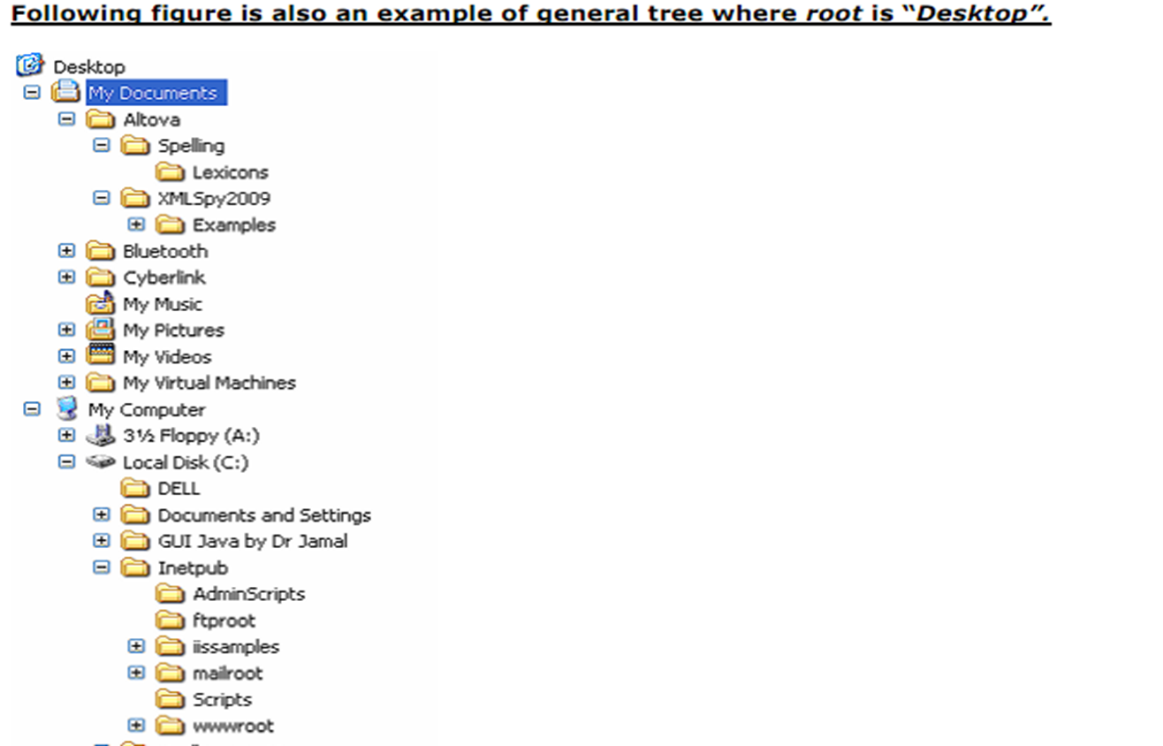

Slide 10
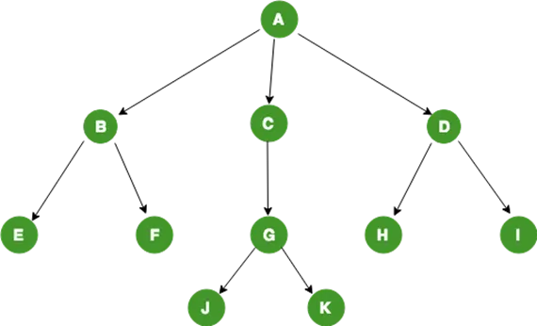
General Tree Structure

Slide 11
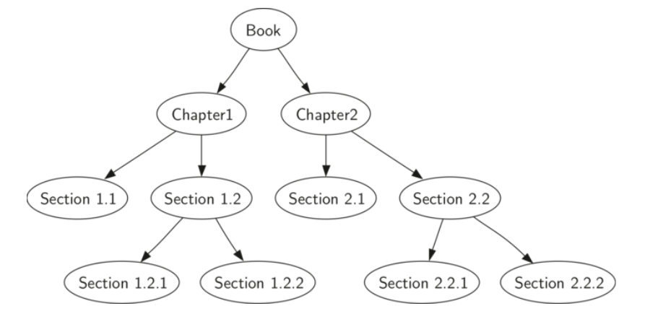
Tree Example

Slide 12
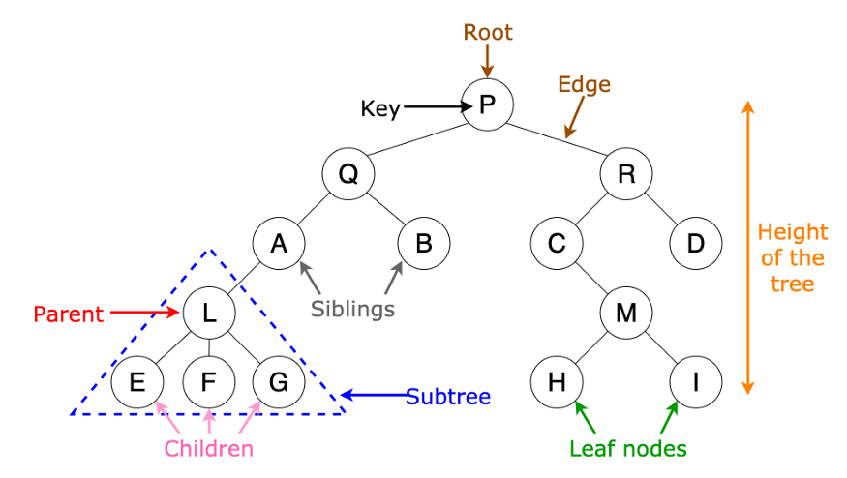
Trees: Basic terminology

Slide 13
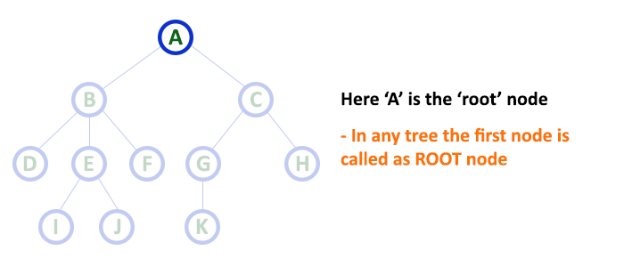
Trees: Basic terminology
1. Root
In a tree data structure, the first node is called as Root Node. Every tree must have a root node. We can say that the root node is the origin of the tree data structure. In any tree, there must be only one root node. We never have multiple root nodes in a tree.

Slide 14
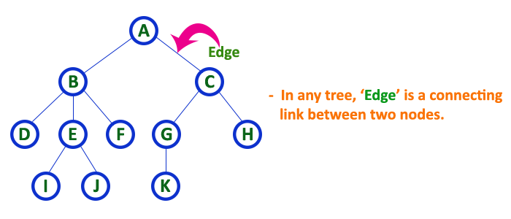
Trees: Basic terminology
2. Edge
In a tree data structure, the connecting link between any two nodes is called as EDGE. In a tree with 'N' number of nodes there will be a maximum of 'N-1' number of edges.

Slide 15
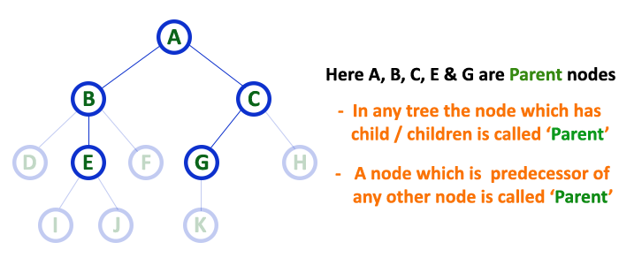
Trees: Basic terminology
3. Parent
In a tree data structure, the node which is a predecessor of any node is called as PARENT NODE. In simple words, the node which has a branch from it to any other node is called a parent node. Parent node can also be defined as "The node which has child / children".

Slide 16
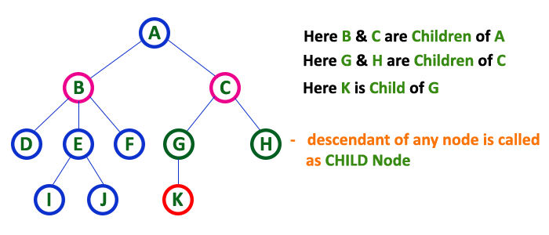
Trees: Basic terminology
4. Child
In a tree data structure, the node which is descendant of any node is called as CHILD Node. In simple words, the node which has a link from its parent node is called as child node. In a tree, any parent node can have any number of child nodes. In a tree, all the nodes except root are child nodes.

Slide 17
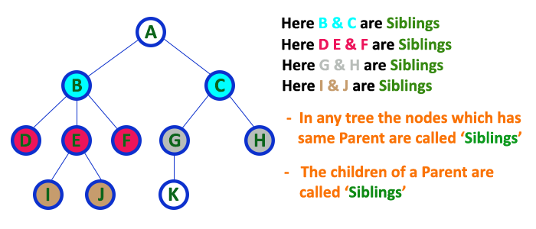
Trees: Basic terminology
5. Siblings
In a tree data structure, nodes which belong to same Parent are called as SIBLINGS. In simple words, the nodes with the same parent are called Sibling nodes.

Slide 18
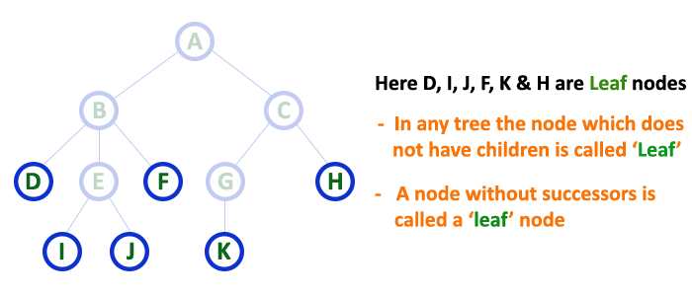
Trees: Basic terminology
6. Leaf
In a tree data structure, the node which does not have a child is called as LEAF Node. In simple words, a leaf is a node with no child.

Slide 19
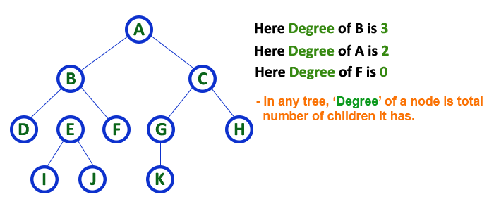
Trees: Basic terminology
7. Degree
In a tree data structure, the total number of children of a node is called as DEGREE of that Node.

Slide 20
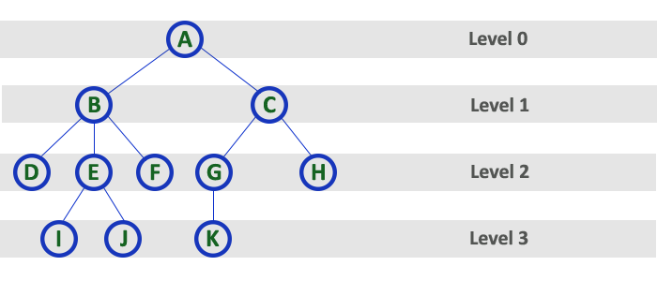
Trees: Basic terminology
8. Level
In a tree data structure, the root node is said to be at Level 0 and the children of root node are at Level 1 and the children of the nodes which are at Level 1 will be at Level 2 and so on... In simple words, in a tree each step from top to bottom is called as a Level and the Level count starts with '0' and incremented by one at each level (Step).

Slide 21
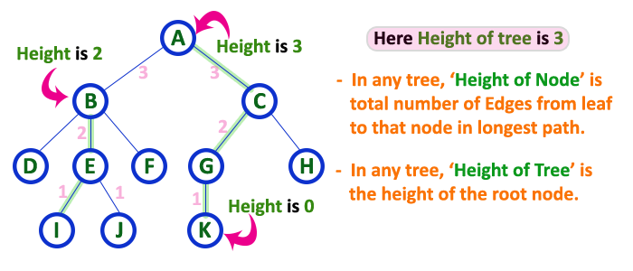
Trees: Basic terminology
9. Height
In a tree data structure, the total number of edges from leaf node to a particular node in the longest path is called as HEIGHT of that Node. In a tree, height of the root node is said to be height of the tree. In a tree, height of all leaf nodes is '0'.

Slide 22
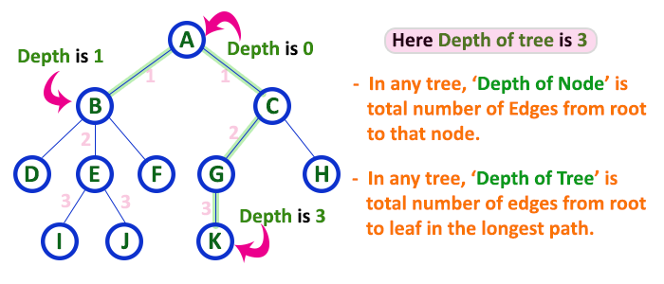
Trees: Basic terminology
10. Depth
In a tree data structure, the total number of edges from root node to a leaf node in the longest path is said to be Depth of the tree. In a tree, depth of the root node is '0'.

Slide 23
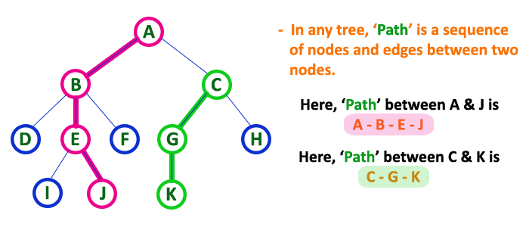
Trees: Basic terminology
11. Path
In a tree data structure, the sequence of Nodes and Edges from one node to another node is called as PATH between that two Nodes. Length of a Path is total number of nodes in that path. In below example the path A - B - E - J has length 4.

Slide 24
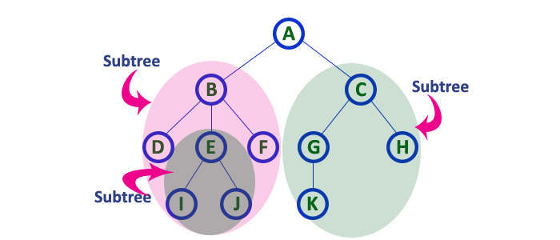
Trees: Basic terminology
12. Sub Tree
In a tree data structure, each child from a node forms a subtree recursively. Every child node will form a subtree on its parent node.

Slide 25
Types of Tree Data Structures
Following are some types of trees that we discuss here:
General Tree
Binary Tree
Binary Search Tree

Slide 26
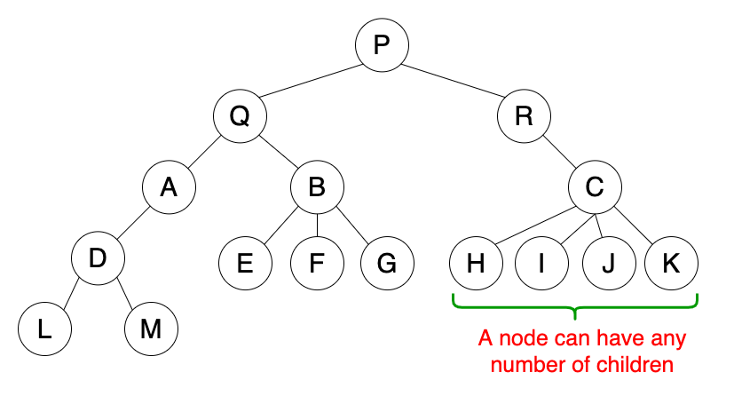
General Tree
A general tree is a tree data structure where there are no constraints on the hierarchical structure.
Properties
A node can have any number of children.
Usage
Used to store hierarchical data such as folder structures.

Slide 27
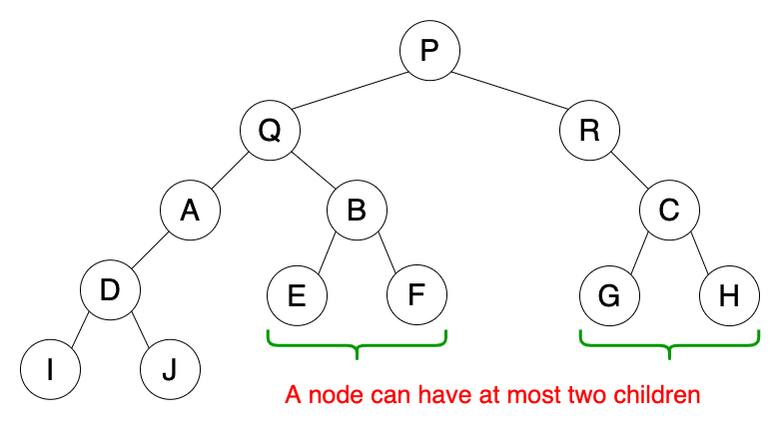
Binary Tree
Binary tree is the type of tree in which each parent can have at most two children.
The children are referred to as left child or right child.
This is one of the most commonly used trees.
When certain constraints and properties are imposed on Binary tree it results in a number of other widely used trees like BST (Binary Search Tree),

Slide 28
Binary Tree
There are different types of binary trees and they are...
Strictly Binary Tree
Complete Binary Tree
Extended Binary Tree

Slide 29
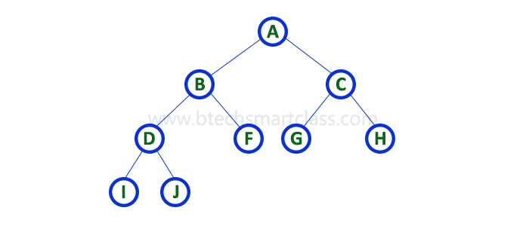
1. Strictly Binary Tree
In a binary tree, every node can have a maximum of two children.
But in strictly binary tree, every node should have exactly two children or none. A strictly Binary Tree can be defined as follows...
“A binary tree in which every node has either two or zero number of children is called Strictly Binary Tree”
Strictly binary tree is also called as Full Binary Tree or Proper Binary Tree or 2-Tree

Slide 30
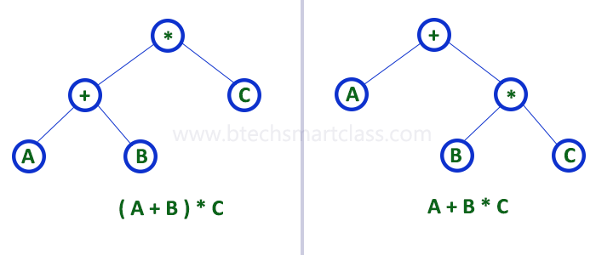
1. Strictly Binary Tree
Strictly binary tree data structure is used to represent mathematical expressions.

Slide 31
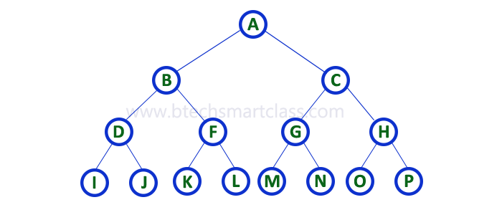
2. Complete Binary Tree
In a binary tree, every node can have a maximum of two children.
But in strictly binary tree, every node should have exactly two children or none
In complete binary tree all the nodes must have exactly two children
And at every level of complete binary tree there must be 2^{level} number of nodes.
For example at level 2 there must be 2² = 4 nodes and at level 3 there must be 2³ = 8 nodes.
Complete binary tree is also called as Perfect Binary Tree

Slide 32
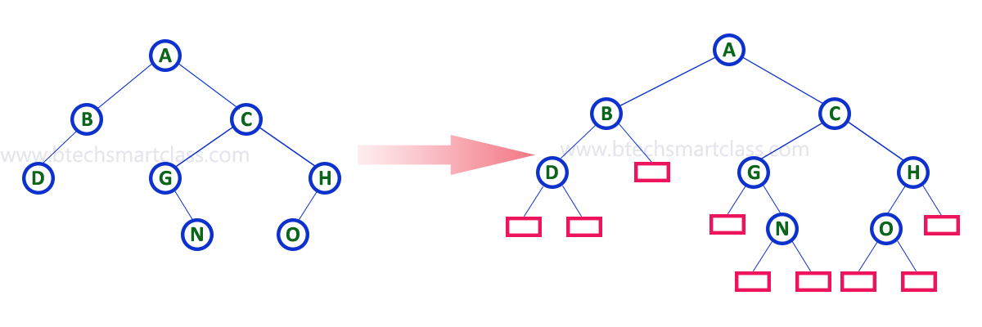
3. Extended Binary Tree
A binary tree can be converted into Full Binary tree by adding dummy nodes to existing nodes wherever required.
“The full binary tree obtained by adding dummy nodes to a binary tree is called as Extended Binary Tree."

